Slide 1


SocialBuzz
Accenture

Slide 2






Who are we?
Bhairavi
Wadekar
Daksh
Arora
Rahul
Dhomane
Roshan
Shetty
Sumaita
Ahmed
accenture

Slide 3







Agenda
Problem Statement
Recommendation
Analysis
Implementation
Risk & Mitigation
Conclusion & QnA
accenture

Slide 4



SocialBuzz
-
Founded In
2010
+
Providing users with over 100 ways to react
Headquarter
San Francisco
Monthly Active User
500M +
Highly focused on data privacy, protection and anonymity
Content Published Everyday
100,000+
accenture

Slide 5
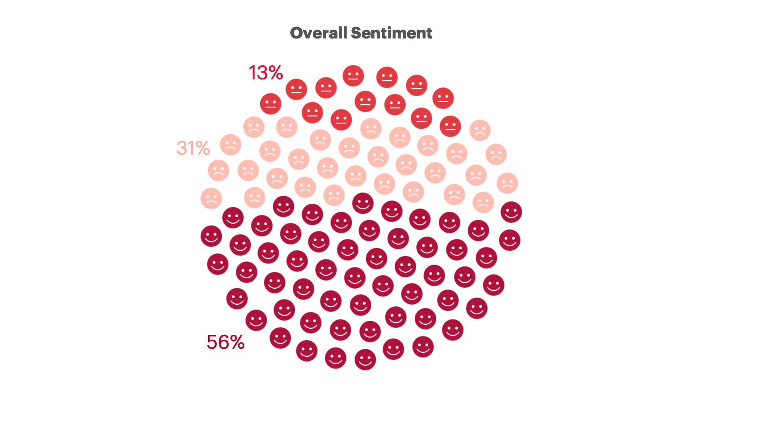
SocialBuzz
How are your users feeling?
User Experience Map
31% reactions are negative
56% reactions are positive
accenture

Slide 6
Problem Statement
What strategy should SocialBuzz implement to increase user engagement level and improve user experience?
Key Tasks
Minimize negative user interaction with personalized content
Improve user engagement and experience
Improve targeted advertising based on user preference
Problem
Statement
Implementation
Risks & Mitigations
Recommendation
Analysis
Conclusion
accenture

Slide 7

So let’s answer the question
How do you actually do it?

Slide 8

Recommendation
Buzz-Craft
Problem
Statement
Implementation
Risks & Mitigations
Recommendation
Analysis
Conclusion
accenture

Slide 9

Recommendation
BUZZ CRAFT
+
=
Buzz Crafted
Content Crafting
Medium Crafting
Problem
Statement
Implementation
Risks & Mitigations
Recommendation
Analysis
Conclusion
accenture

Slide 10




Recommendation
For Category: Animal
Above Average
Below Average
Medium
Science
Food
Travel
Education
Veganism
Public Speaking
Problem
Statement
Implementation
Risks & Mitigations
Recommendation
Analysis
Conclusion
accenture

Slide 11
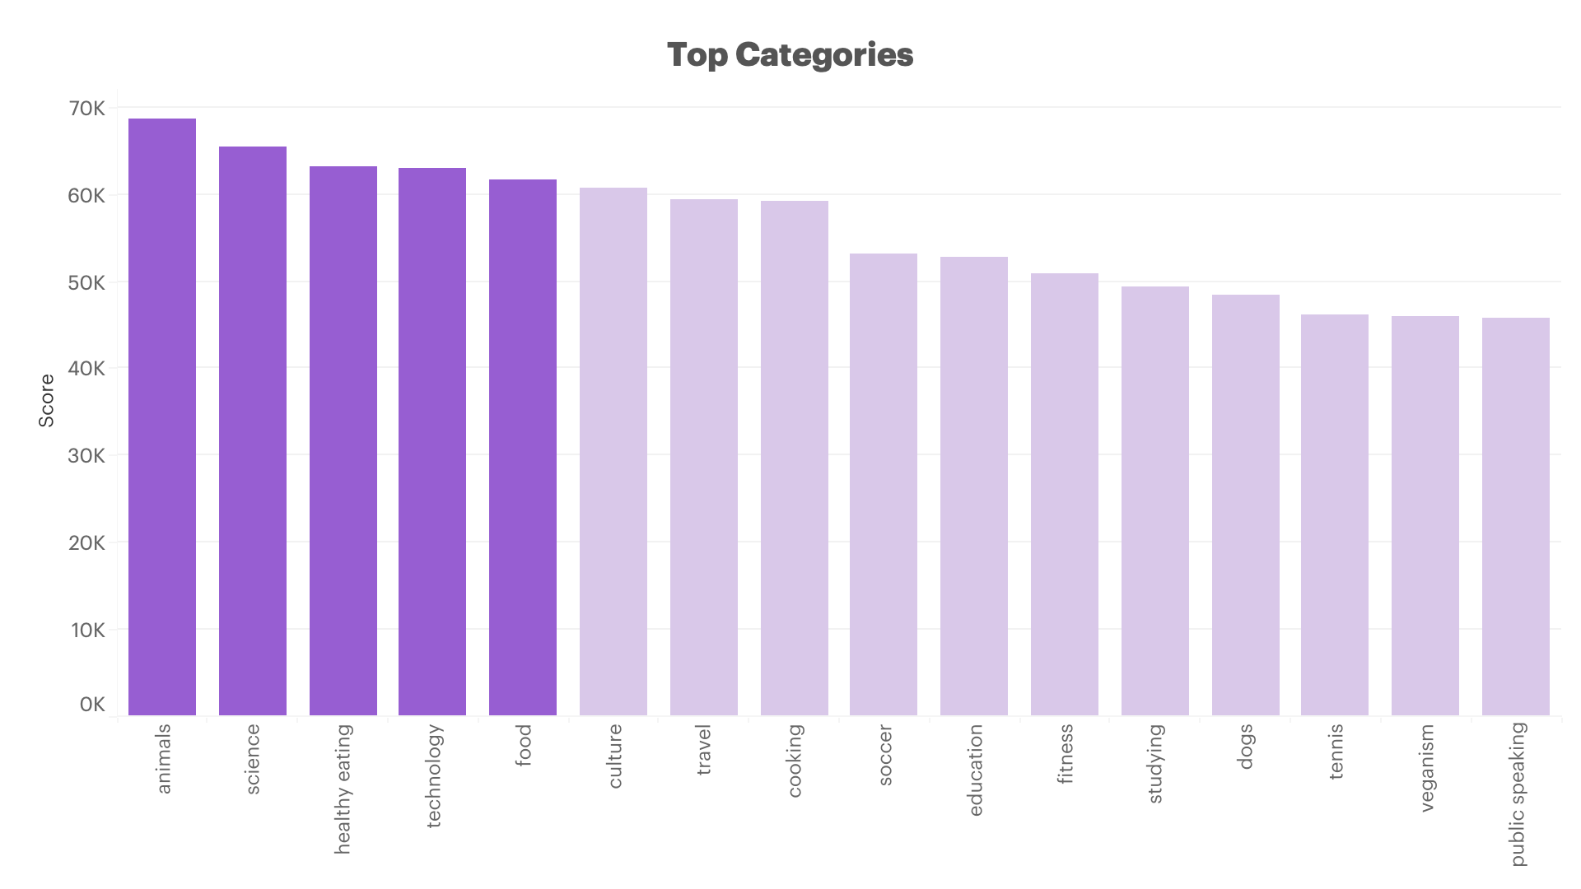
Analysis
Top Categories
The top 5 categories are calculated using aggregated scores across all the user reactions.
Problem
Statement
Implementation
Risks & Mitigations
Recommendation
Analysis
Conclusion
accenture

Slide 12
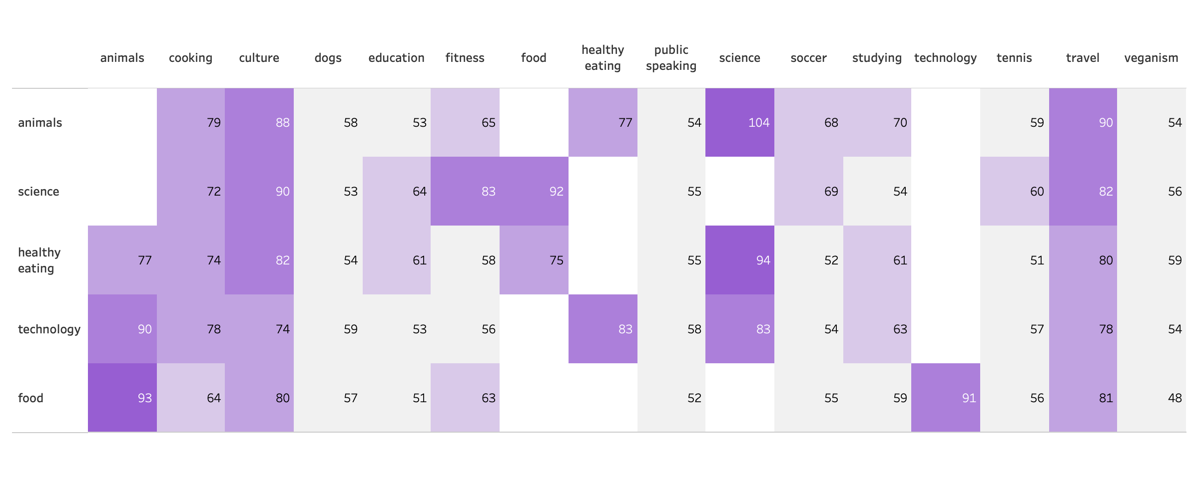
Analysis
User Experience Map
Problem
Statement
Implementation
Risks & Mitigations
Recommendation
Analysis
Conclusion
accenture

Slide 13
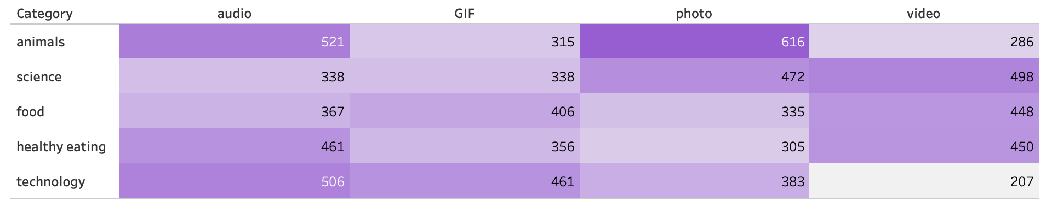
Analysis
Effective Mediums by Category
Problem
Statement
Implementation
Risks & Mitigations
Recommendation
Analysis
Conclusion
accenture

Slide 14
Implementation
Social Buzz should implement the recommendations using the AB Testing model
Analyze metrics to identify the more effective variant and implement changes accordingly.
Develop two versions (A and B) of app feature, or content element
Randomly assign users to either A or B to measure performance
Problem
Statement
Implementation
Risks & Mitigations
Recommendation
Analysis
Conclusion
accenture

Slide 15
Risk & Mitigation
Changing user preference - Failure to adapt to changing preferences may result in users migrating to platforms that better cater to their current interests.
Mitigation - leverage data analytics to track user behavior, content consumption patterns, and emerging trends.
Targeting the wrong user market - Different users have distinct preferences for content types, formats, and topics.
Mitigation: Analyze content consumption patterns within potential user markets. Customize content strategies to cater to the preferences of the identified audience segments.
Lack of content diversity: A limited range of content on Social Buzz may result in decreased user engagement, exclusion of potential users, and a competitive disadvantage.
Mitigation: Regularly introduce new content categories aligned with user interests and emerging trends.
Problem
Statement
Implementation
Risks & Mitigations
Recommendation
Analysis
Conclusion
accenture

Slide 16
Conclusion
SocialBuzz
Accenture
Buzz-Craft
Thank you. That's it, folks.
How about some questions?

